Slide 1
Trends in transportation and logistics
M.Grazia Speranza
University of Brescia
17th Swiss Transport Research Conference
Ascona, May 17-19, 2017

Slide 2
Technological trends
IoT
(Internet of Things)
Big data

Slide 3
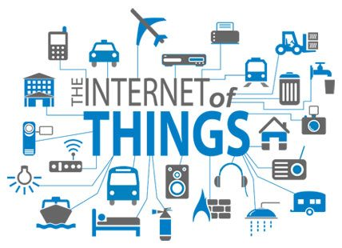
Technological trends
Concept of Internet extended to objects and places

Slide 4
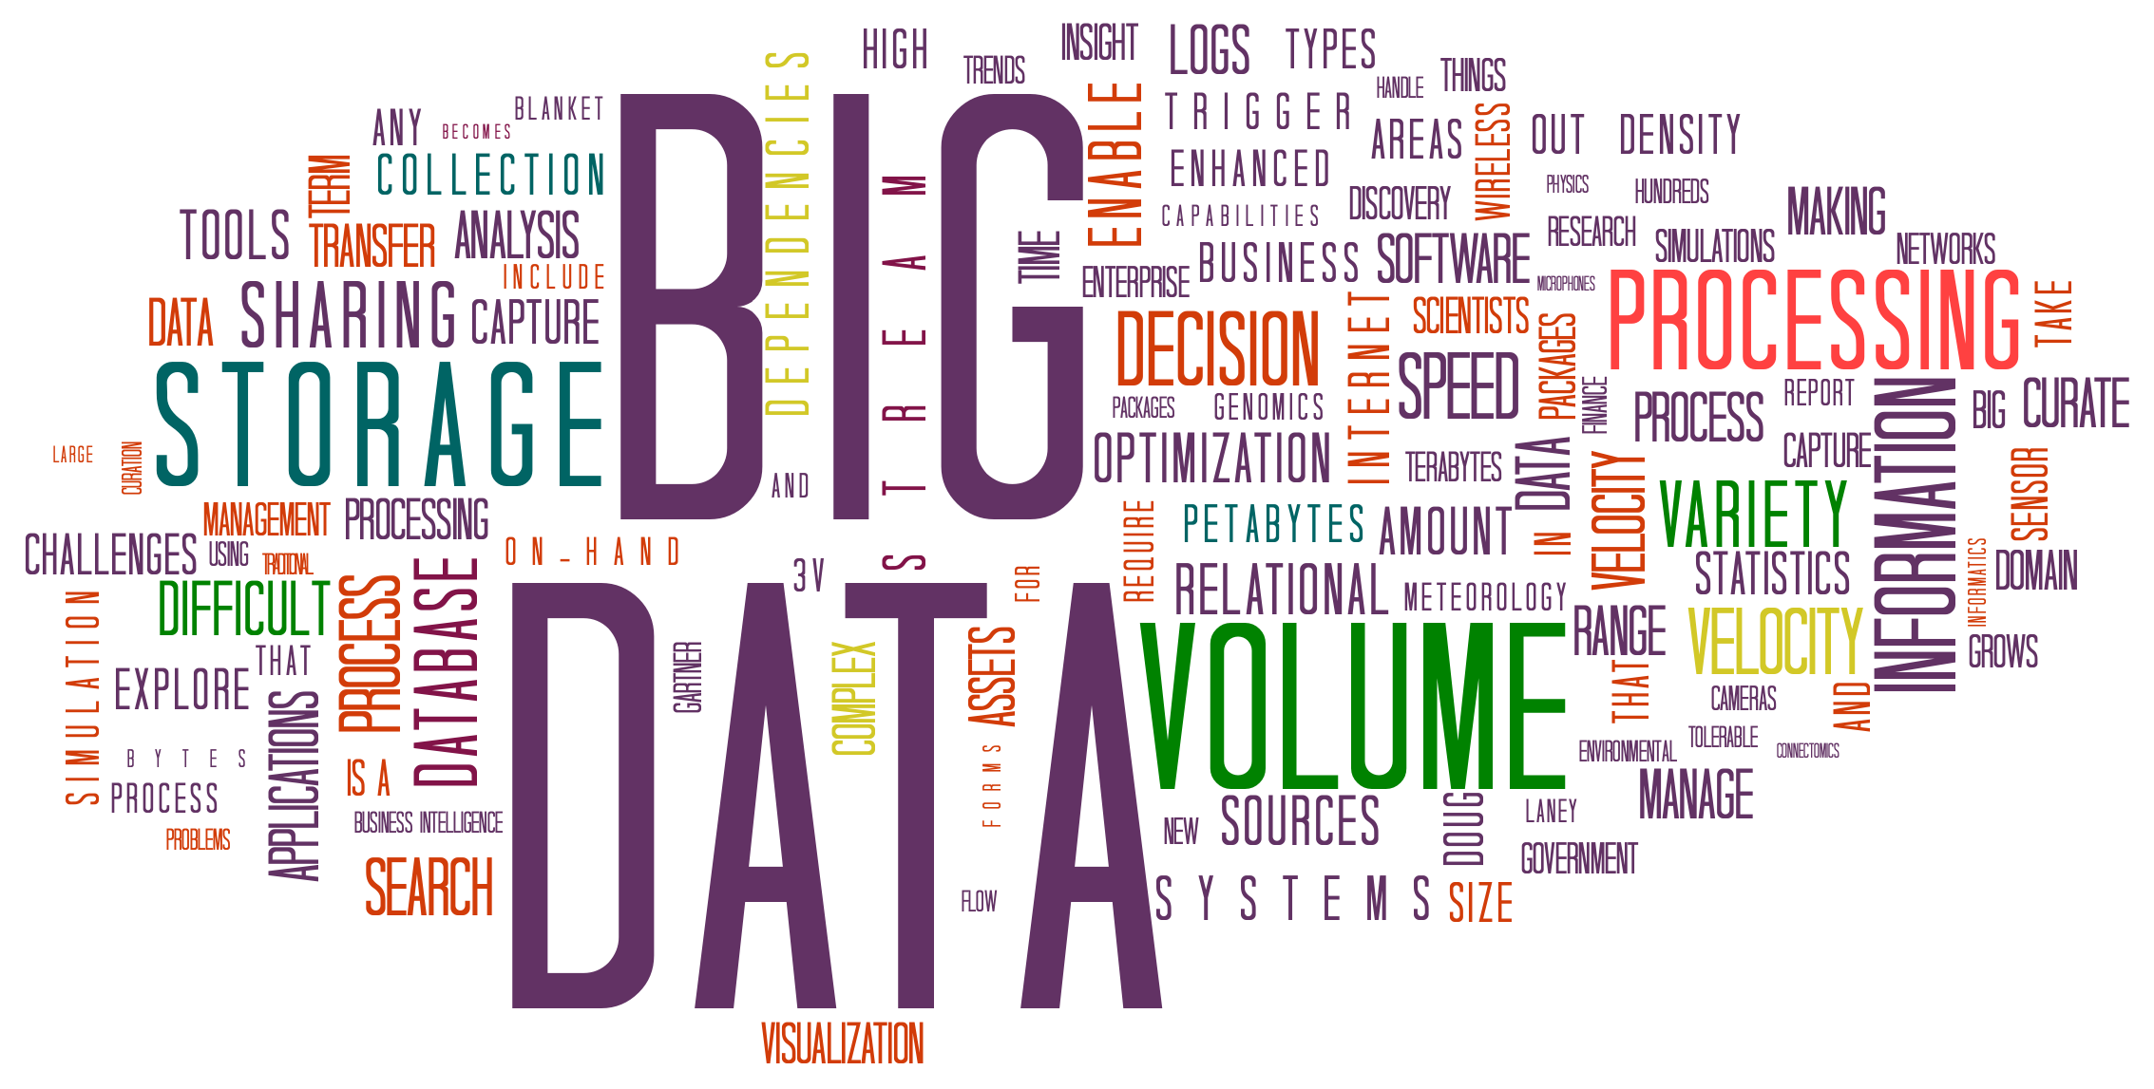
Technological trends
Goal: extraction of value

Slide 5
Logistics and sustainability
Freight transportation causes severe health problems with an impact on cost for the health system estimated in 43-46 billions € per year;
100 billions € per year is the estimated cost for the pollution
(European Agency for Environment "Road user charges for heavy goods vehicles“)
Empty trips in Europe are about 25%,
in Italy about 35%

Slide 6
Trends in supply chain logistics
Systemic focus
Optimization of the entire supply chain network
Customer value co-creation
Information synthesis
Information is holistically shared
Joint interpretation to improve performance
Collaborative relationships
Joint accountability and rewards
Total system value creation
T. Stank, C. Autry, P. Daugherty, D. Closs, Transp. Journal, 2015

Slide 7
Trends in supply chain logistics
Systemic focus
Optimization of the entire supply chain network
Customer value co-creation
Information synthesis
Information is holistically shared
Joint interpretation to improve performance
Collaborative relationships
Joint accountability and rewards
Total system value creation

Slide 8
Trends in supply chain logistics
Systemic focus
Optimization of the entire supply chain network
Customer value co-creation
Information synthesis
Information is holistically shared
Joint interpretation to improve performance
Collaborative relationships
Joint accountability and rewards
Total system value creation

Slide 9
Trends in supply chain logistics
Demand shaping
Proactively influencing demand
Total system value creation
Transformational agility
Constantly changing conditions
Flexible network integration
Dynamic selection of partners upstream and downstream
Global optimization

Slide 10
Trends in supply chain logistics
Demand shaping
Proactively influencing demand
Total system value creation
Transformational agility
Constantly changing conditions
Flexible network integration
Dynamic selection of partners upstream and downstream
Global optimization

Slide 11
Trends in supply chain logistics
Demand shaping
Proactively influencing demand
Total system value creation
Transformational agility
Constantly changing conditions
Flexible network integration
Dynamic selection of partners upstream and downstream
Global optimization

Slide 12
Trends in supply chain logistics
Collaborative
Systemic
Dynamic

Slide 13
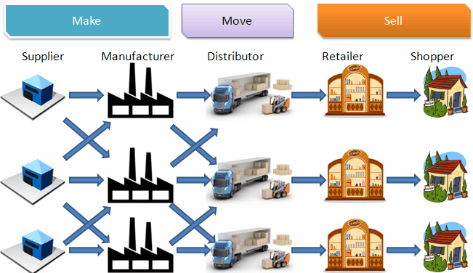
Systemic focus

Slide 14
Systemic focus
Vehicle routing
Warehouse management
Facility location
Lot sizing
Production scheduling
Supply chain network design
Inventory management

Slide 15
Systemic focus: An example
Individual times and quantities fixed

Slide 16
Systemic focus: An example

Slide 17
Systemic focus: An example

Slide 18
Systemic focus: An example

Slide 19
Systemic focus: An example
Joint optimization of times, quantities and routes

Slide 20
Systemic focus: An example
Retailer Managed Inventory
Vendor Managed Inventory
At each retailer (s,S) policy
Heuristic solution of an inventory routing problem
(matheuristic)
Optimal solution of routing problems
(branch-and-cut)
C. Archetti, M.G. Speranza, ITOR, 2016

Slide 21
Systemic focus: An example
Tests on 120 random instances with:
6 days
up to 50 customers
up to 5 vehicles
Average total saving with inventory routing: 10%
Average saving on inventory cost: 15%
Average saving on transportation cost: 9%

Slide 22
Collaborative focus: An example

Slide 23
Collaborative focus: An example
Collaboration scheme

Slide 24
Collaborative focus: An example
Collaboration scheme

Slide 25
Collaborative focus: An example
Collaboration scheme

Slide 26
Collaborative focus: An example
After optimization
more €
more €
more €
Collaboration scheme

Slide 27
Collaborative focus: An example
Truckload service
Some shared customers
Collaboration scheme:
revenue sharing mechanism
Max total profit
E. Fernandez, D. Fontana, M.G. Speranza, Computers & OR, 2016

Slide 28
Collaborative focus: An example
No collaboration max individual profit
With collaboration
constraints are imposed on individual profits
with 2 carriers the solution belongs to the ‘core of the game’

Slide 29
Collaborative focus: An example
Arc routing problem solved with branch-and-cut
944 instances with 2-3 carriers, optimally solved without and with collaboration scheme
Total profit increase:
strongly dependent on the instance
average 9%
maximum 95%
Less transport
E. Fernàndez, M. Roca-Riu, M.G. Speranza, submitted, 2017

Slide 30
Transportation and sustainability
Passenger vehicles are a major pollution contributor, producing significant amounts of nitrogen oxides, carbon monoxide, and other pollution. In 2013, transportation contributed more than half of the carbon monoxide and nitrogen oxides emitted into the air.
People travel by:
private vehicles (72%)
bus (14%)
train (13%)

Slide 31
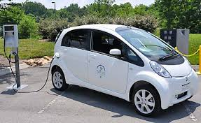
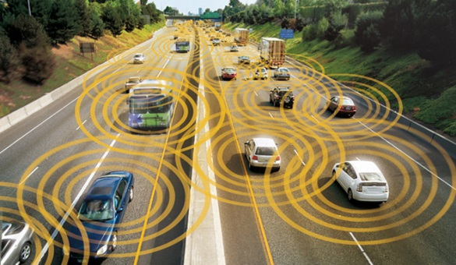
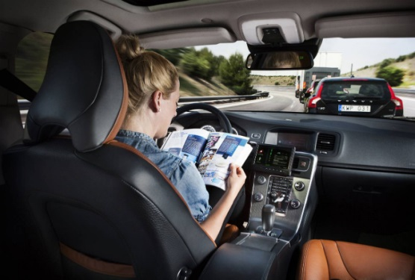
Trends that will change transportation
Electric vehicles
More and more economical
Transit buses
and short-range vehicles
Connected vehicles
Traffic data
Internet connectivity
Autonomous vehicles
Hands-free and feet-free driving
Fully autonomous

Slide 32
Trends that will change transportation
Collaborative consumption
On-demand mobility
Enable mobility without mostly unused cars
Efficient multi-modal networks
Crowdsourcing transit data
Multiple trip options

Slide 33
Trends that will change transportation
Individual vehicle
Can we reduce
the number of traveling vehicles and the parking space?
Can we reduce congestion
for a given number of traveling vehicles?

Slide 34
Trends that will change transportation
Individual vehicle
Can we reduce
the number of traveling vehicles and the parking space?
Can we reduce congestion
for a given number of traveling vehicles?

Slide 35
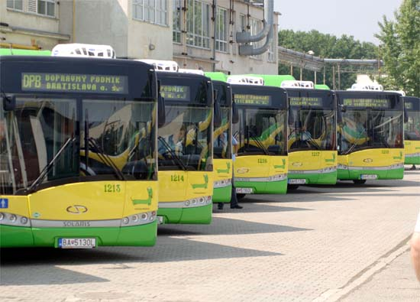
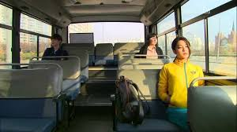
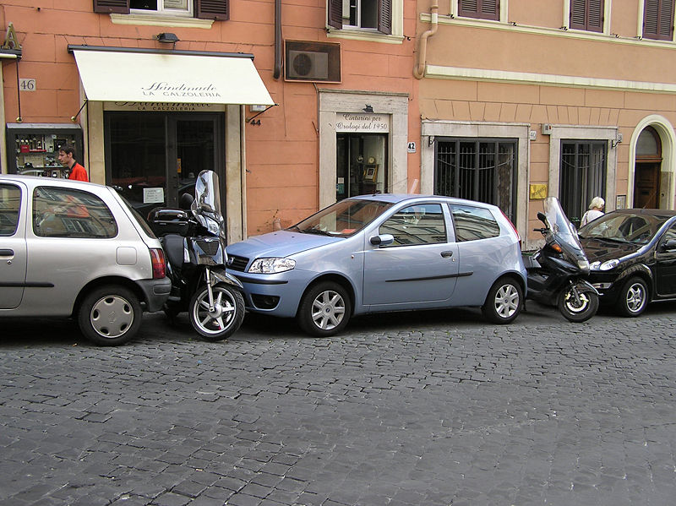
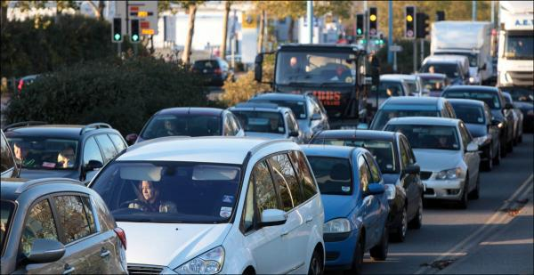
Reduction of traveling vehicles

Slide 36
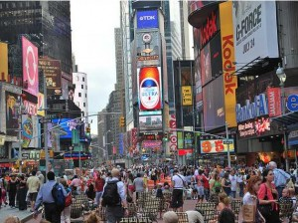
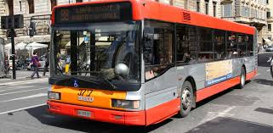
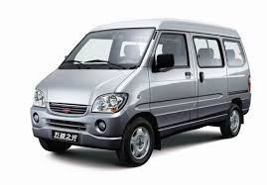
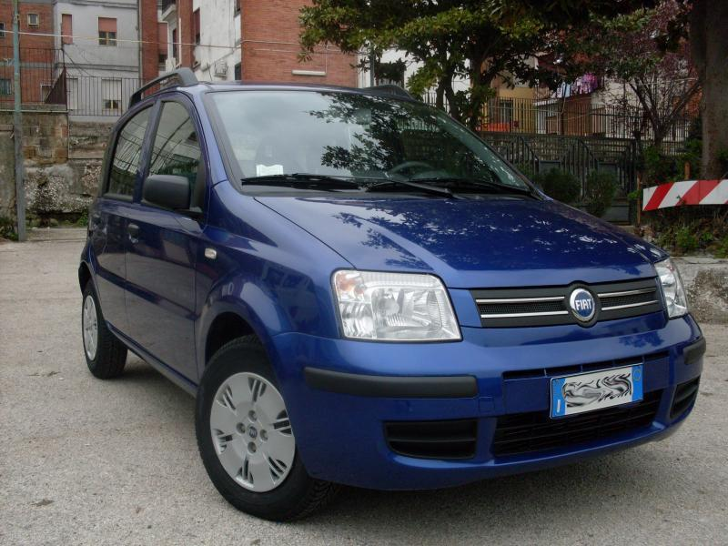
Reduction of traveling vehicles
On-demand
C. Archetti, M.G. Speranza, D. Weyland, submitted, 2016

Slide 37
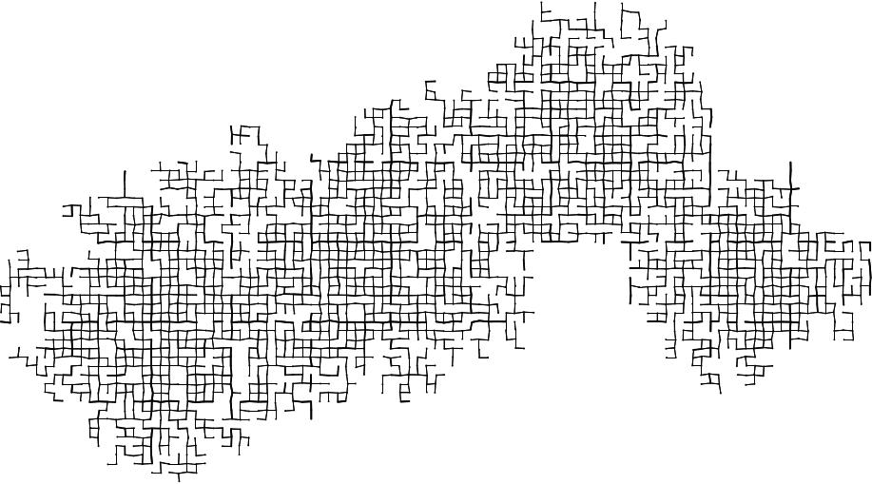
Reduction of traveling vehicles
A simulation model
Input:
Origins
Destinations
Request time
Desired departure time
Flexibility factor

Slide 38
Reduction of traveling vehicles
Direct trips
On-demand public transportation service
Public transportation by bus
Public transportation is chosen if allowed by the flexibility factor
The public service with shorter traveling time is chosen

Slide 39
Reduction of traveling vehicles
Output:
Requests served by mode
Average travel time per request
Average distance per request
Economic indicators
Average cost per request
Environmental indicators
Average fuel consumption per request
Pollution

Slide 40
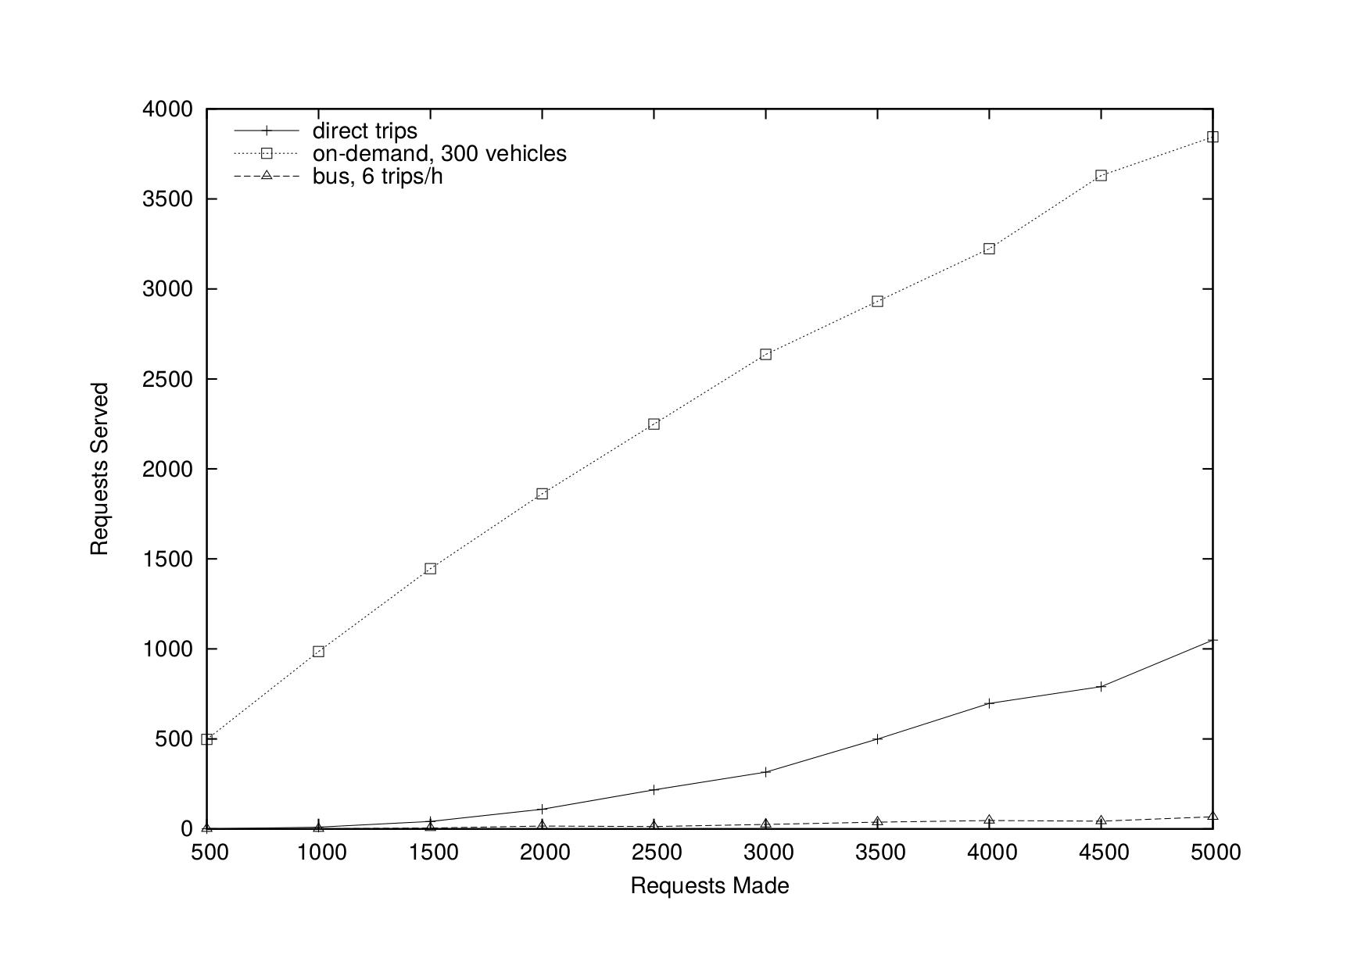
Reduction of traveling vehicles

Slide 41
Trends that will change transportation
Individual vehicle
Can we reduce
the number of traveling vehicles and the parking space?
Can we reduce congestion
for a given number of traveling vehicles?

Slide 42
The concept of congestion
Given the road networks
Given less polluting – electric – vehicles
Given autonomous or partially autonomous vehicles
What can be done to reduce congestion?
Reduce the number of traveling vehicles or….

Slide 43
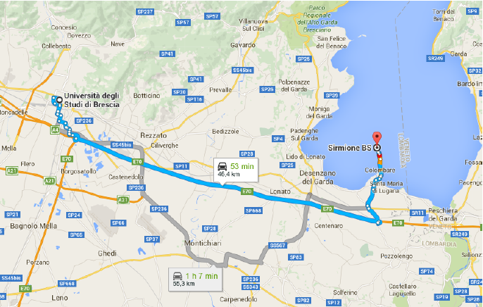
The shortest path….

Slide 44
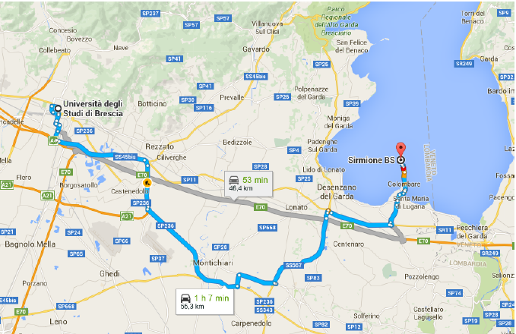
….but we may prefer a longer path

Slide 45
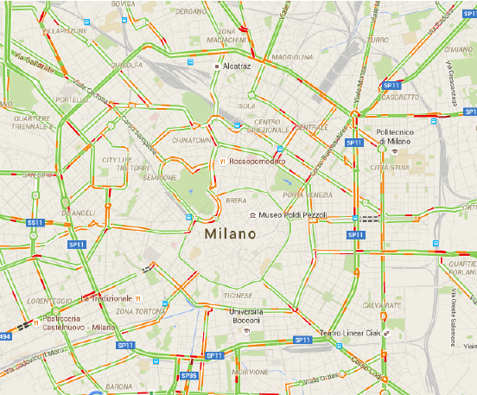
Does traffic information help?

Slide 46
Does traffic information help?
There may be many alternatives with different levels of congestions
The question is: What will the other drivers do?
Information may just move congestion

Slide 47
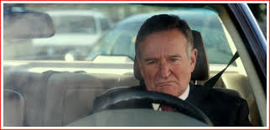
Travel inconvenience and congestion
Congestion is the result of individual decisions
But we can coordinate decisions

Slide 48
The literature
Y. Sheffi, Prentice Hall, 1985
Rush hour traffic often exhibits a steady-state behaviour
H. Mahmassani, S. Peeta, TR Record, 1993
User-optimal vs system-optimal paths
O. Jahn et al, OR, 2005
System-optimal distribution that ensures fairness

Slide 49
The literature
Y. Sheffi, Prentice Hall, 1985
Rush hour traffic often exhibits a steady-state behaviour
H. Mahmassani, S. Peeta, TR Record, 1993
User-optimal vs system-optimal paths
O. Jahn et al, OR, 2005
System-optimal distribution that ensures fairness

Slide 50
Individual route choice and congestion
The more we allow
individual shortest paths to increase
the more we can reduce congestion
The idea:
To distribute the flow on different paths,
given a maximum allowed inconvenience

Slide 51
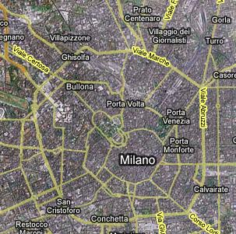
A model for proactive route guidance
E. Angelelli, I. Arsik, V. Morandi, M. Savelsbergh, M.G. Speranza, TR B, 2016

Slide 52
A model for proactive route guidance
Input:
Graph representing the city
Arc capacities
OD pairs and flows
For each OD pair all paths not longer than (1+τ)SP
Output:
Number of vehicles that use each path, for each OD pair
maximum travel inconvenience

Slide 53
A model for proactive route guidance
System goal: Min congestion
User goal: Min travel inconvenience
Hierarchical objectives:
Min max arc utilization
Min average travel inconvenience

Slide 54
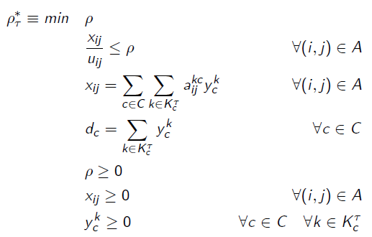
The congestion model
maximum arc utilization, i.e. congestion
1 or less means
no congestion
flow for OD pair c on path k

Slide 55
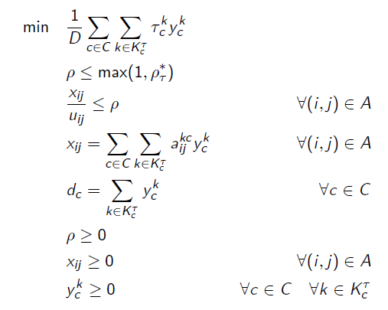
The inconvenience model
average inconvenience
we aim at being at level 1, that is without congestion
flow for OD pair c on path k

Slide 56
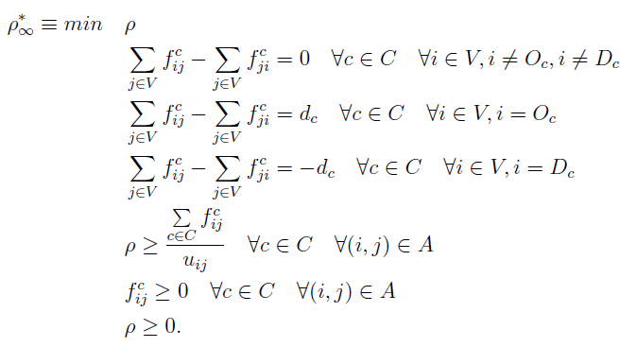
The unconstrained congestion model
minimum possible level of congestion
flow for OD pair c on arc (i,j)

Slide 57
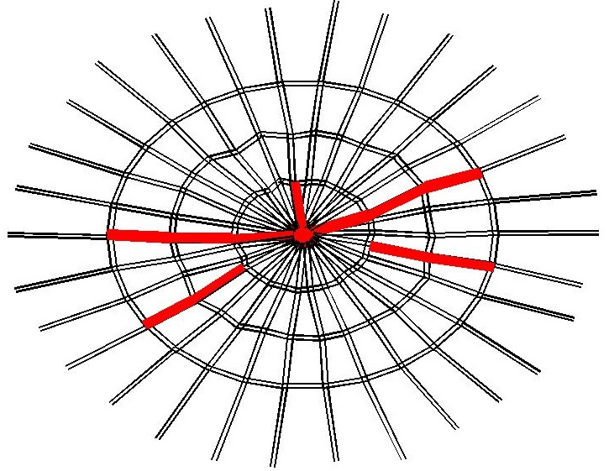
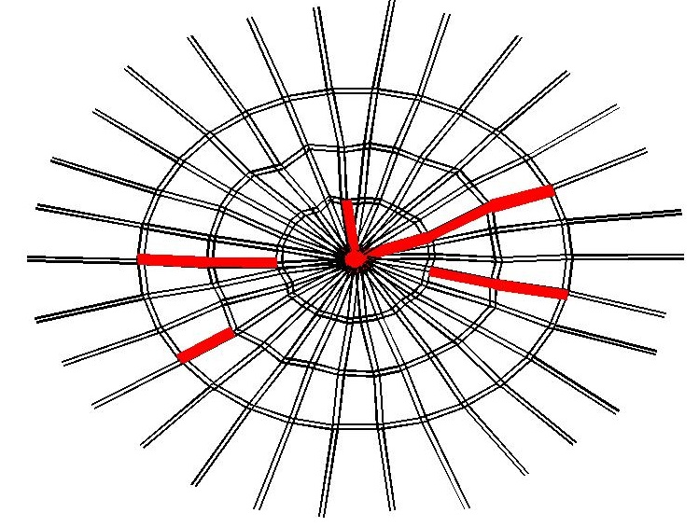
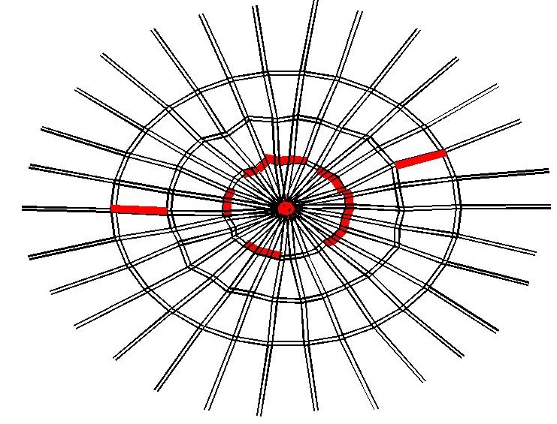
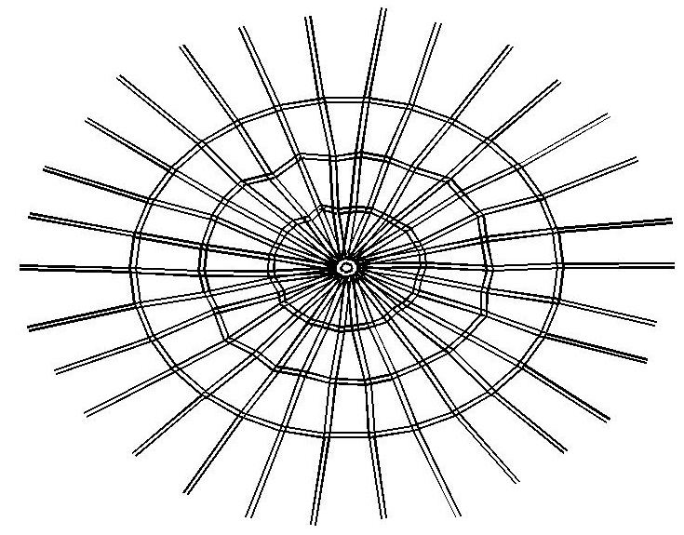
Congested arcs
τ=0%
τ=5%
τ=15%
τ=25%

Slide 58
Instances
Big and small-medium cities
Oligo- and poli-centric cities (few and several destinations)
Off-peak and in-peak period (small and high OD demand)
Semicircular and circular structure
Small and moderate in-city traffic (in-city origins)

Slide 59
One instance
Big and small-medium cities
Oligo- and poli-centric cities (few and several destinations)
Off-peak and in-peak period (small and high OD demand)
Semicircular and circular structure
Small and moderate in-city traffic (in-city origins)

Slide 60
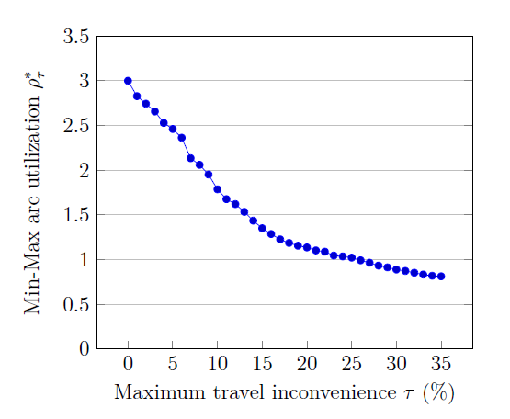
Congestion vs inconvenience

Slide 61
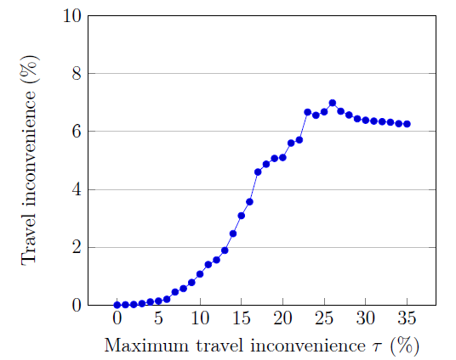
Average vs max inconvenience

Slide 62
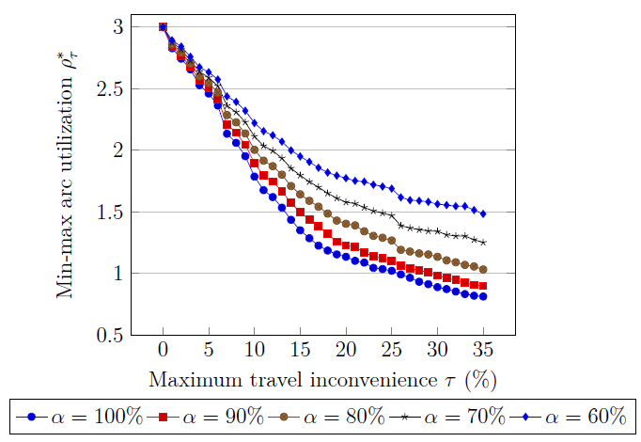
Impact of compliance rate

Slide 63
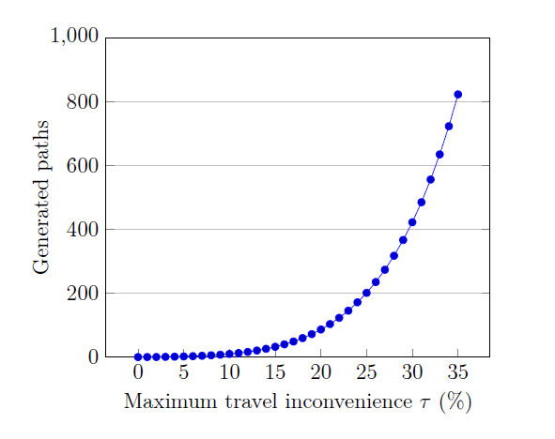
Average number of paths per OD pair

Slide 64
Developments
Computational challenge:
the number of paths
Good heuristic
E. Angelelli, V. Morandi, M. G. Speranza, submitted, 2016
Traffic dependent travel times
Piecewise linear approximation
E. Angelelli, V. Morandi, M. Savelsbergh, M. G. Speranza, submitted, 2017

Slide 65
Developments
Min max congestion
or
Min average congestion?
Min the congestion of a given % of the most congested arcs (CVaR)

Slide 66
Conclusions and future research
Exciting new problems in transportation and logistics

